Slide 1
新增intro
改了大綱 related work
Experiment component缺圖
心得也寫了
你覺得不OK的都可以直接改

Slide 2
人流計算
第24組
0716059巫奇翰
0716301劉育源
0716310翁瑞澤

Slide 3
大綱
Motivation
Intro
Related works
Architecture
Experiment Conponent
Result
What we learned from this project

Slide 4


動機

Slide 5
Intro
Object Tracking = Object detection + tracker
Single object trackers: the bounding box of the target in the first frame is given to the tracker. The goal of the tracker is then to locate the same target in all the other frames. Most are detection free tracking.
Multiple object track finding algorithms: The tracking algorithm is expected first to determine the number of objects in each frame, and second, to keep track of each object’s identity from one frame to the next. Most are detection based tracking.

Slide 6
Related works
Object Detection:
Haar-like feature: Rapid Object Detection Using a Boosted Cascade of Simple Features
HOG feature: Histogram of oriented gradients features
R-CNN: Real-Time Object Detection with Region Proposal Network
YOLOv4: Optimal Speed and Accuracy of Object Detection
Multiple Object Tracking (MOT):
SORT: Simple online and realtime tracking
DeepSORT: Simple Online and Realtime Tracking with a Deep Association Metric
JDE: Towards Real-Time Multi-Object Tracking

Slide 7
Architecture: A self-designed MOT framework
Purpose:
簡單替換 detector 或 tracker演算法
功能：
Detect
Track
Display
Optimize
Arhcitecture Graph:
Detector
Optimizer
Optimized model
Tracker
Displayer
Video stream
Notes:
Detector:
base: opencv haar cascade
advance: yolo
input: frame
output: bounding boxes
Tracker:
base: opencv tracker
advance: SORT or DeepSORT
input: bounding boxes
output: assigned IDs
Display
base: 我打算用嵌入式系統的 flask 做 video stream，很簡單，翁要也行，記得不能在 main thread 跑，把 debug 設成 False 就能在 其他 thread app.start()了
advance: 有想到再考慮要不要，這部分沒那麼重要，其實有 base 就夠了
input: frame + bounding boxes with ID
output: display input frame by somehow
Benchmarker
反正就是做 benchmark input 自己訂
output: performance metrics for MOT, e.g., MOTA(先這個就好) or MOTP or FPS(這個應該很簡單也做一下)
Optimizer (advance)
Netadapt:

Slide 8
Architecture: Person counter
利用我們自己做的framework做一個人流計算器。
Our
Framework
Bounding boxes 和 IDs
Counter
人員進出淨值

Slide 9
Flow chart
loop
Frame
source
frame
Detection
And IDs
Update
ID Database
MOT
Detection
And IDs
ID info
Update
Frame
Cond?
Cond 0: 出現於建築外，消失於建築內
Cond 1: 出現於建築內，消失於建築外
Cond 2: else
0
1
2
+1
-1
pass

Slide 10
Experiment Component
Dataset: Oxford Town Centre
Detector: Haar cascade、YOLOv5
Tracker: SORT
Optimizer: Netadapt

Slide 11
Experiment Component
Haar cascade Classifier
Based on adaboost algorithm
Haar-like feature
Positive and negative images are used to train the classifier
Lightweight and fast

Slide 12
Experiment Component
YOLO(You only look once)
Region-free(whole frame)
Predict bounding boxes with confidence
CNN
Fast and accurate

Slide 13
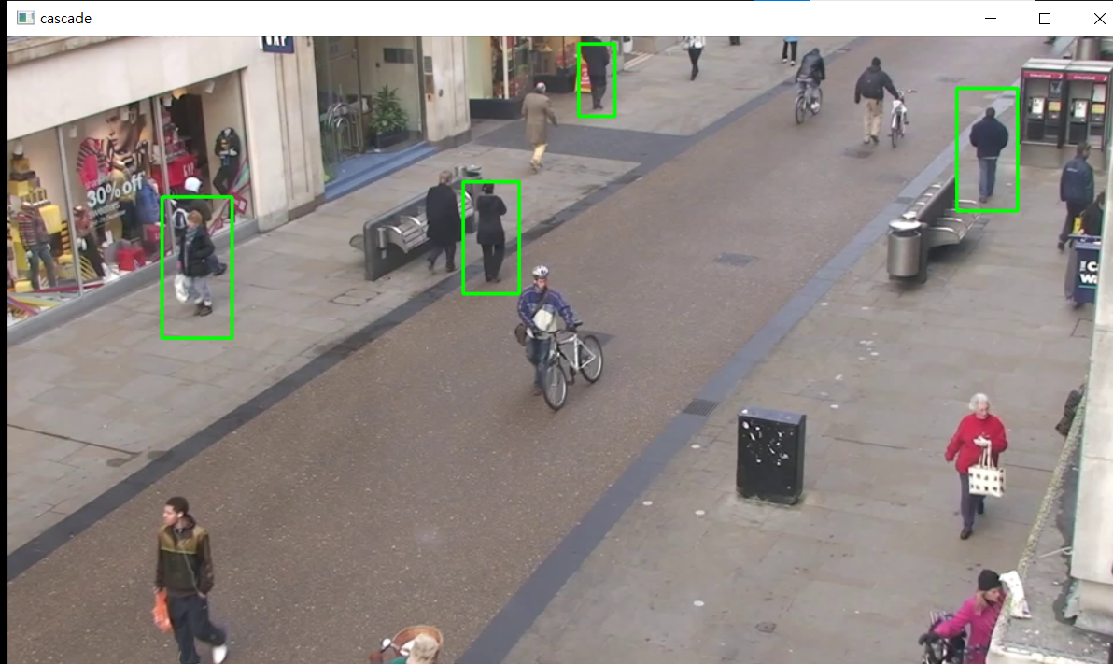
Experiment Component
Haar cascade detection
YOLOv5 detection

Slide 14
Experiment Component
SORT
Kalman filter: used to predict next bounding box
Hungarian algorithm: calculate correlation of detection & prediction
MOTA close to state-of-the-art
High performance of ID switching

Slide 15
Experiment Component
NetAdapt

Slide 16
Result

Slide 17
What we learned from this project
Detecting 跟 Tracking根據演算法的不同，可以是獨立的，也可以是合作的。Single object tracker速度比detecting快，可是需要處理追蹤物件消失的問題； Detection based tracking則需要處理ID switching的問題，同時受限於龐大的model與計算量，兩者各有優缺。不過現在也有研究者嘗試將single object tracker使用在MOT問題上，希望能夠引起新的研究方向。

